Slide 1
BASIC CALCULATOR
BY:PRIYANSHU KUMAR
DATE:- Nov 2024

Slide 2
Agenda
Introduction
Backend
Frontend

Slide 3
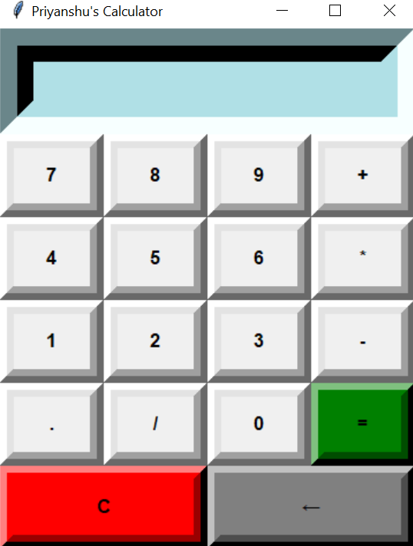
Introduction
Key Features:
Simple arithmetic operations (addition, subtraction, multiplication, division).
Interactive graphical user interface (GUI) built with Tkinter.
Tools & Technologies Used:
Programming Language: Python
Library: Tkinter for GUI

Slide 4
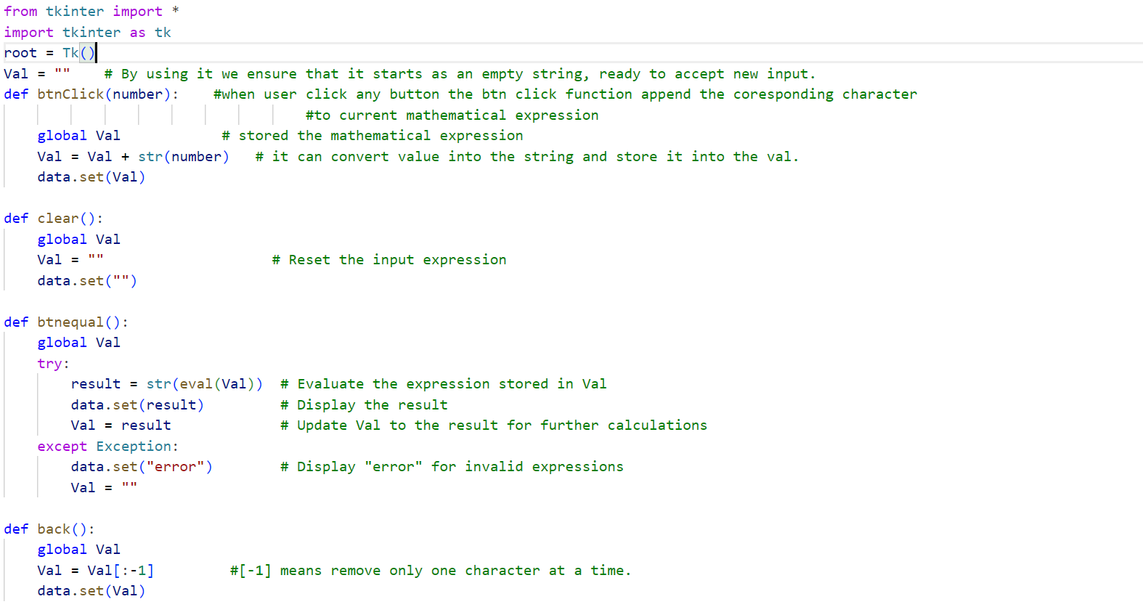
Backend

Slide 5
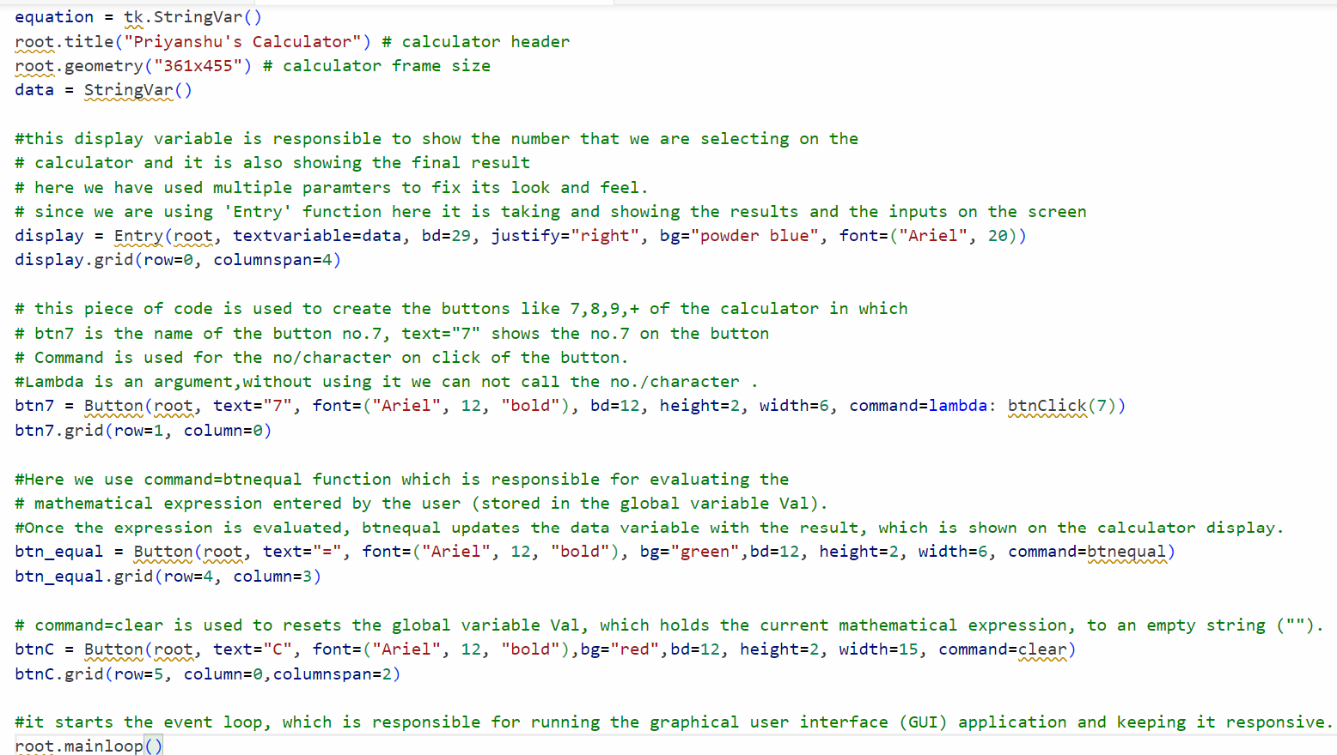
Frontend

Slide 6
Thankyou

